Slide 1
Book1
File created on: 25/10/2021 15:40:58

Slide 2
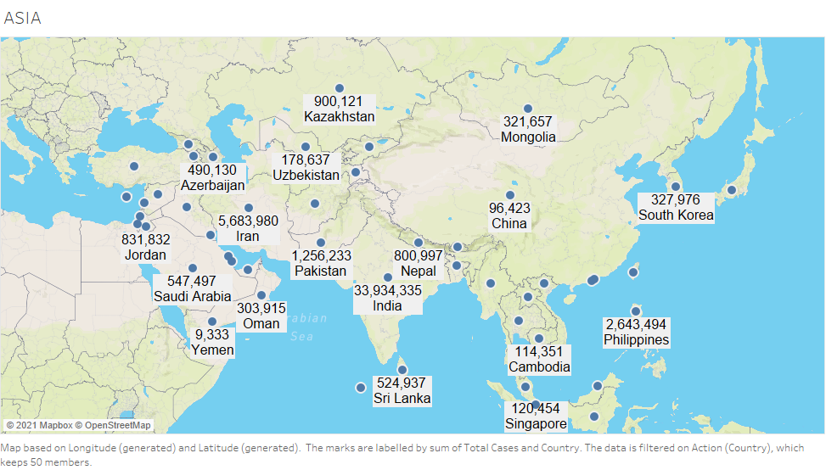

Slide 3
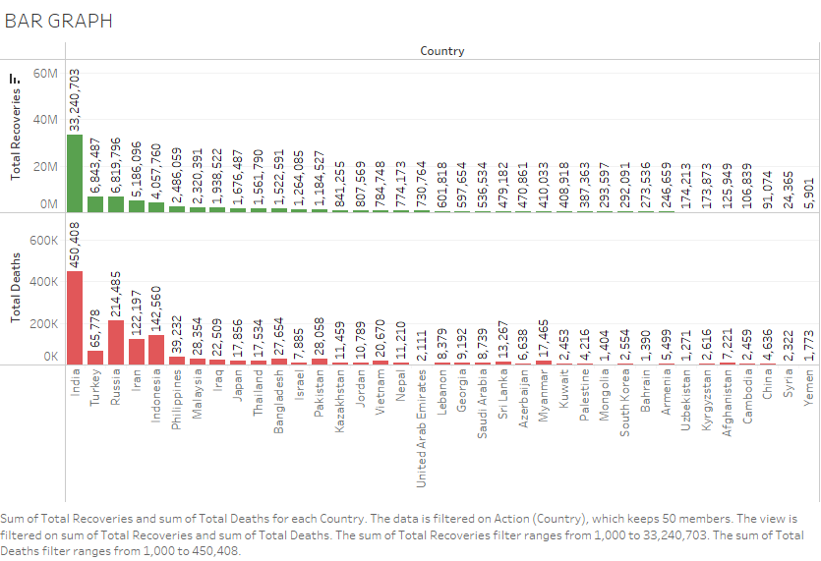

Slide 4
